Slide 1
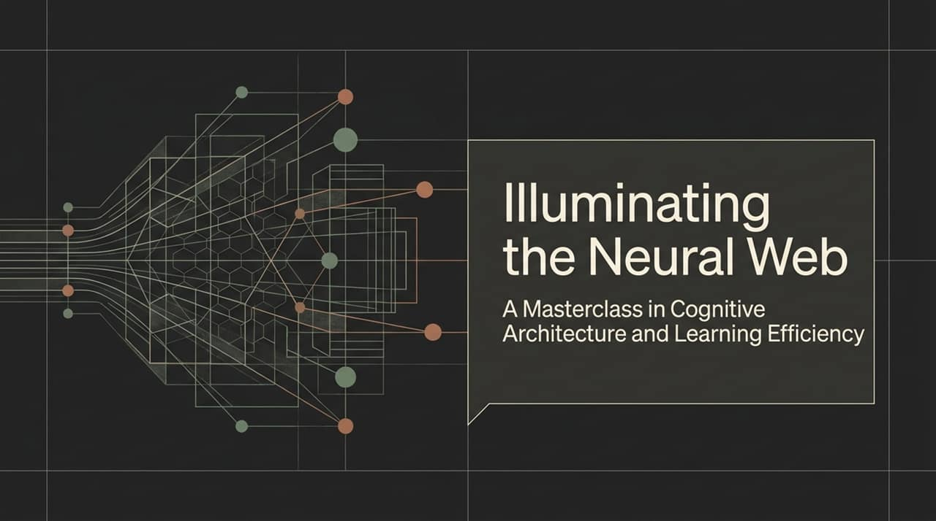
Notes:
Welcome, everyone. Today, we’re embarking on a deep dive into cognitive architecture and learning efficiency. Most people view learning as an act of passive consumption—reading a textbook, watching a video, or highlighting notes. However, true mastery isn't about collecting information; it’s about constructing a resilient, interconnected neural web. In this masterclass, we will challenge common misconceptions about how our brains process knowledge and break down the exact cognitive framework needed to learn faster, retain information permanently, and apply complex concepts under real-world pressure.

Slide 2
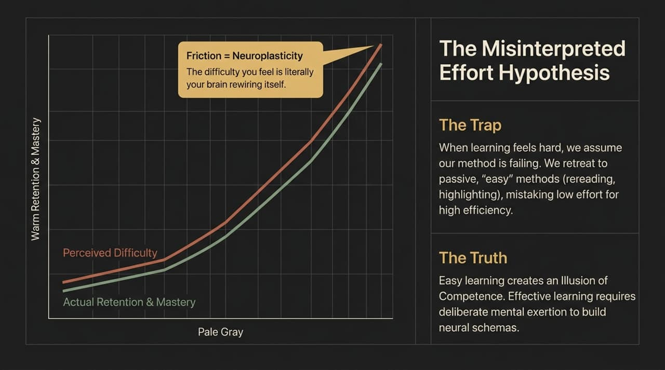
Notes:
Let’s start by addressing a fundamental psychological trap: The Misinterpreted Effort Hypothesis. When learning feels difficult, our natural instinct is to assume our method is failing. We feel mental friction, confusion, or exhaustion, and so we retreat to 'easy' passive activities like re-reading or highlighting.
Here is the critical paradigm shift: Friction is not failure; friction is neuroplasticity. The discomfort you feel during challenging learning is literally your brain rewiring its neural pathways. Easy learning creates an 'Illusion of Competence'—it feels fluent in the moment, but leads to rapid forgetting. True retention requires deliberate mental exertion to build long-lasting neural schemas.

Slide 3
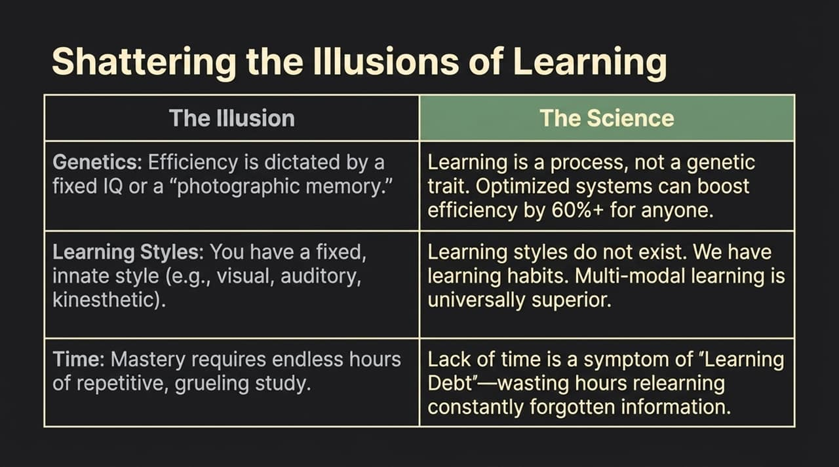
Notes:
To master cognitive architecture, we must shatter three pervasive myths:
Genetics: The myth claims high efficiency is limited to fixed IQ or photographic memory. The science shows learning is a process, not a genetic sentence. With optimized encoding systems, anyone can increase learning efficiency by over 60%.
Learning Styles: Many believe they are strictly visual, auditory, or kinesthetic learners. Cognitive neuroscience has thoroughly debunked this; learning styles are merely habits. Multi-modal, integrated learning is universally superior for every brain.
Time: People think mastery requires thousands of hours of grueling, repetitive study. In reality, a lack of time is usually a symptom of 'Learning Debt'—the endless hours wasted re-learning information that was poorly encoded in the first place.

Slide 4
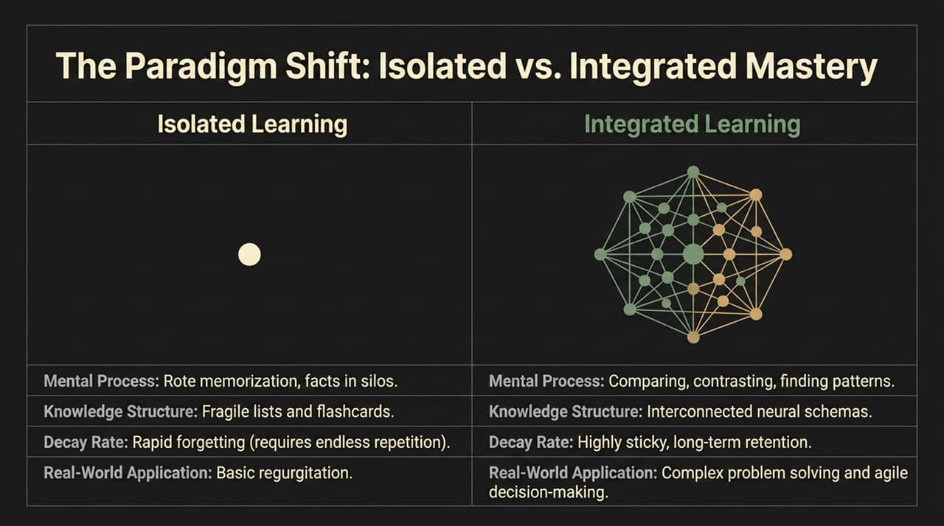
Notes:
Now, let's contrast two fundamentally different approaches to learning: Isolated versus Integrated.
Isolated Learning relies on rote memorization, creating fragile lists and flashcards. Because these facts sit in isolated silos, they suffer from rapid decay, requiring endless repetition just to maintain basic regurgitation.
Integrated Learning, on the other hand, actively compares, contrasts, and identifies underlying patterns. Instead of separate facts, it constructs interconnected neural schemas. Knowledge becomes sticky, long-lasting, and easily transferable to complex problem-solving and real-world execution.

Slide 5
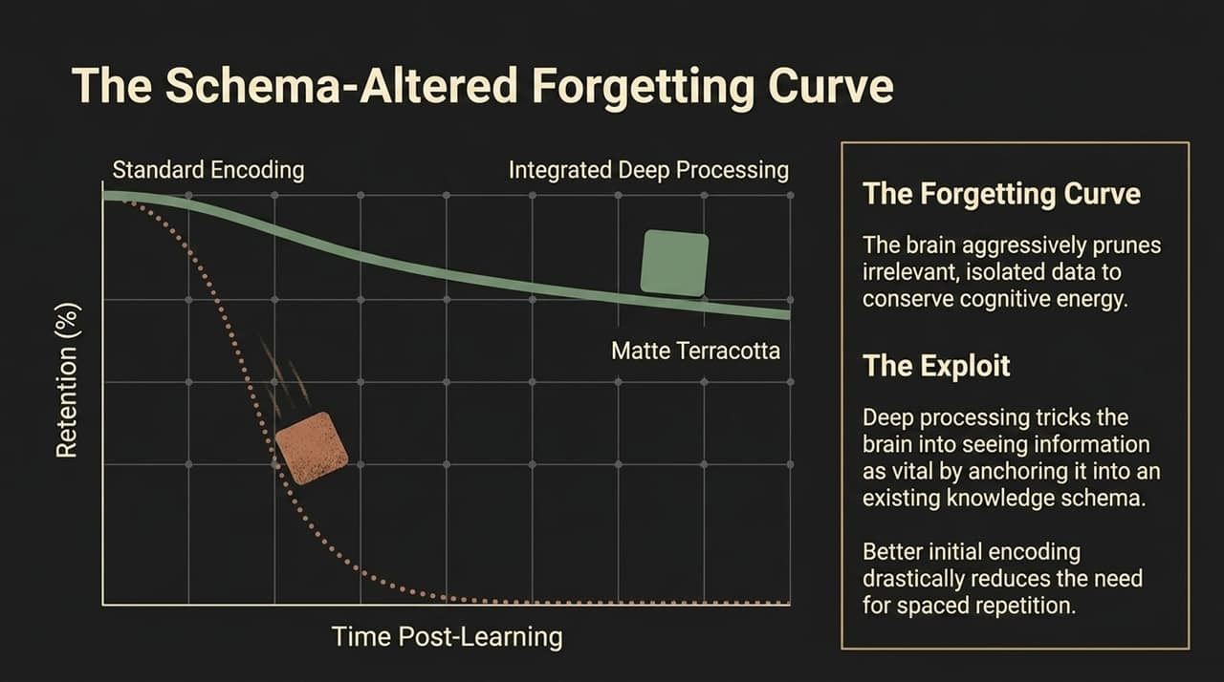
Notes:
We are all familiar with Ebbinghaus’s Forgetting Curve—the rapid loss of memory over time. Why does this happen? Because the brain aggressively prunes data it deems irrelevant to conserve cognitive energy.
But here is the exploit: Deep processing tricks the brain. By anchoring new information into an existing knowledge schema during initial exposure, the brain categorizes that information as vital context rather than disposable noise. High-quality initial encoding drastically flattens the forgetting curve, reducing the sheer volume of spaced repetition needed later.

Slide 6
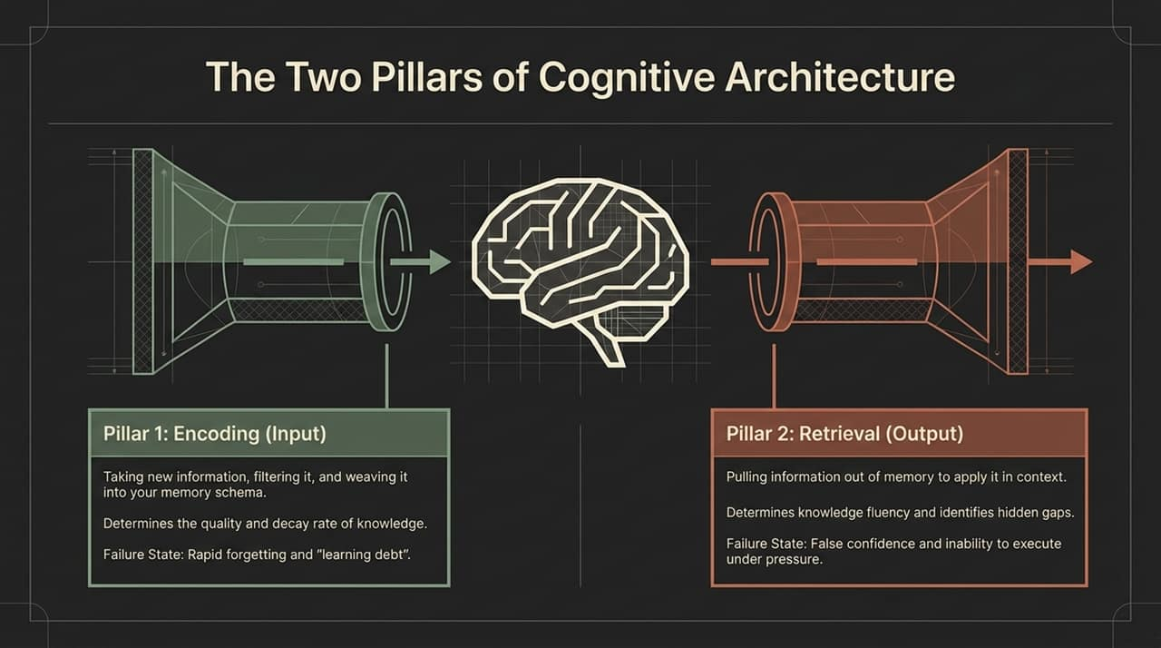
Notes:
Every learning system rests on two primary pillars:
Pillar 1 is Encoding (Input). This is how you take raw information, filter it, and weave it into your mental schema. Encoding dictates the quality and longevity of memory. If encoding fails, you enter 'Learning Debt'.
Pillar 2 is Retrieval (Output). This is pulling stored information out of memory to apply it. Retrieval tests fluency and exposes hidden blind spots. If retrieval fails, you suffer from false confidence—knowing a concept in theory but freezing under pressure.

Slide 7
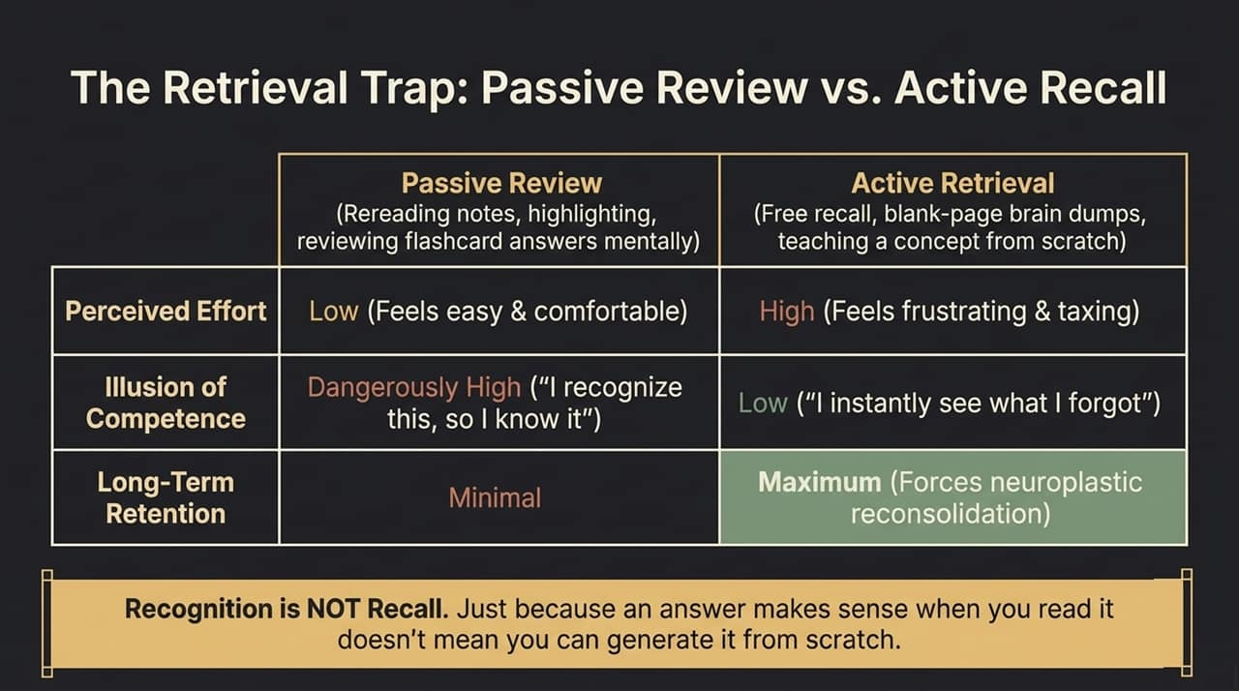
Notes:
Not all retrieval is created equal. Many fall into the 'Retrieval Trap' by substituting Passive Review (rereading notes, scanning flashcards) for Active Retrieval (free recall, teaching from a blank slate).
Passive review feels low-effort and comfortable, giving you a dangerously high illusion of competence: 'I recognize this, so I must know it.' But recognition is NOT recall. Active retrieval feels taxing and frustrating, but it forces neuroplastic reconsolidation, ensuring maximum long-term retention.

Slide 8
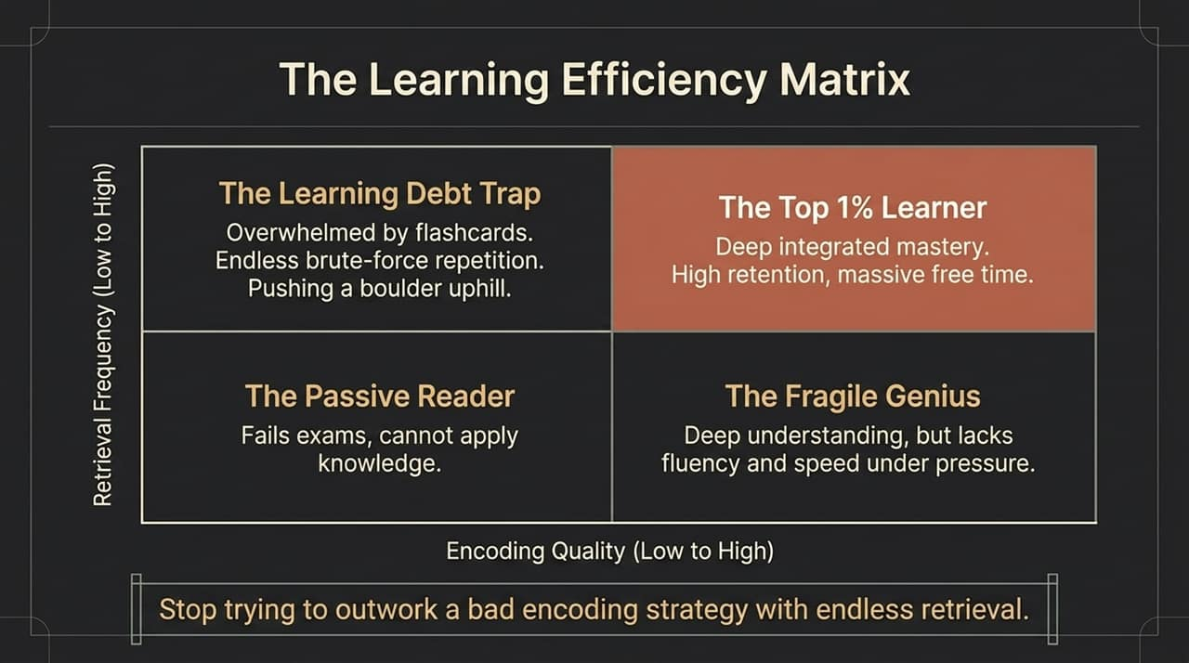
Notes:
Where do you fit in the Learning Efficiency Matrix?
Low Encoding + Low Retrieval: The Passive Reader. Fails exams and cannot apply concepts.
High Encoding + Low Retrieval: The Fragile Genius. Has deep conceptual understanding, but lacks speed and execution under pressure.
Low Encoding + High Retrieval: The Learning Debt Trap. This is the person doing 500 flashcards a day, pushing a boulder uphill through brute-force repetition.
High Encoding + High Retrieval: The Top 1% Learner. Deeply integrated mastery, near-permanent retention, and massive amounts of free time saved.
The core lesson here: Stop trying to outwork a bad encoding strategy with endless retrieval.

Slide 9
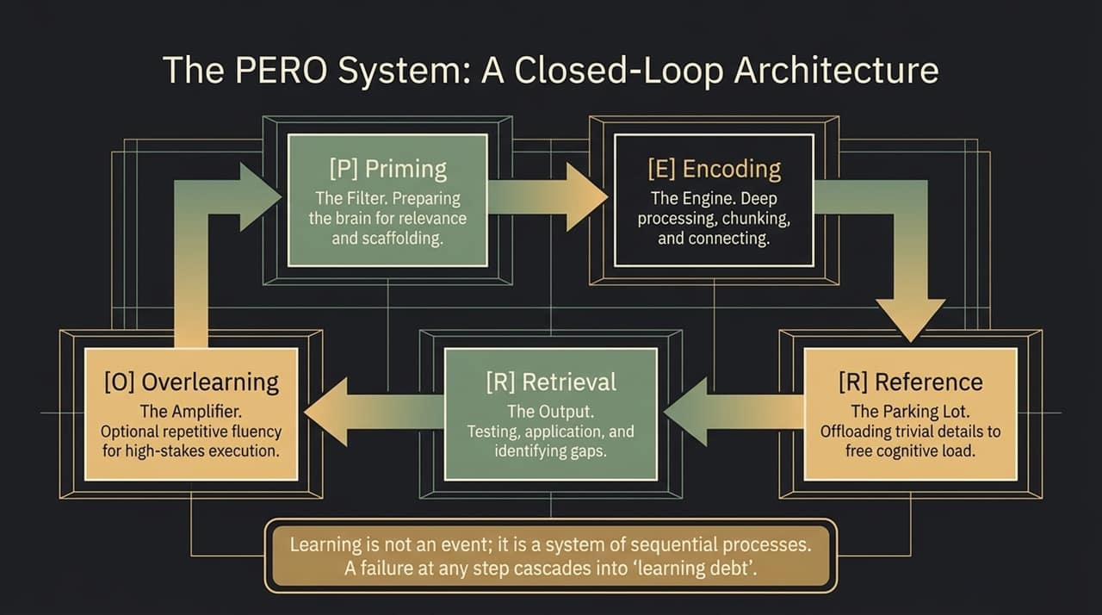
Notes:
To achieve top 1% learning, we implement the PERO System—a closed-loop cognitive process:
Priming [P]: Preparing the brain's filters for relevance.
Encoding [E]: The engine where deep processing, chunking, and conceptual connections happen.
Reference [R]: Offloading trivial details into a 'parking lot' so cognitive energy isn't wasted.
Retrieval [R]: Output testing to reveal gaps and solidify memory.
Overlearning [O]: Optional repetitive fluency for ultra-high-stakes execution.
Learning is not a one-off event; it is a sequential chain. A breakdown at any single stage cascades into learning debt.

Slide 10
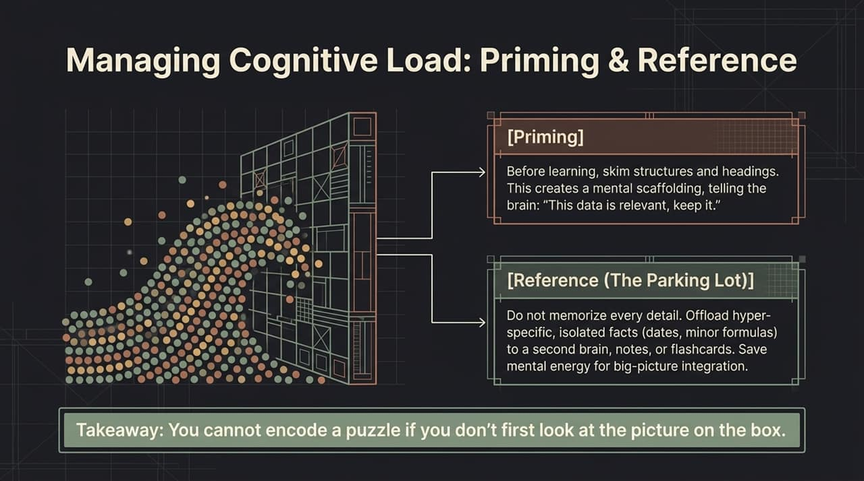
Notes:
Let's focus on managing working memory capacity using Priming and Reference.
Priming means skimming headings, structures, and big ideas before diving into detail. It builds a mental framework that tells your brain, 'This incoming data matters, keep it.'
Reference (The Parking Lot) is offloading hyper-specific facts like minor formulas or exact dates into notes or flashcards. Don't clog your primary working memory with trivialities. Save your active cognitive capacity for big-picture integration. Remember: You cannot assemble a jigsaw puzzle if you haven't looked at the picture on the box first.

Slide 11
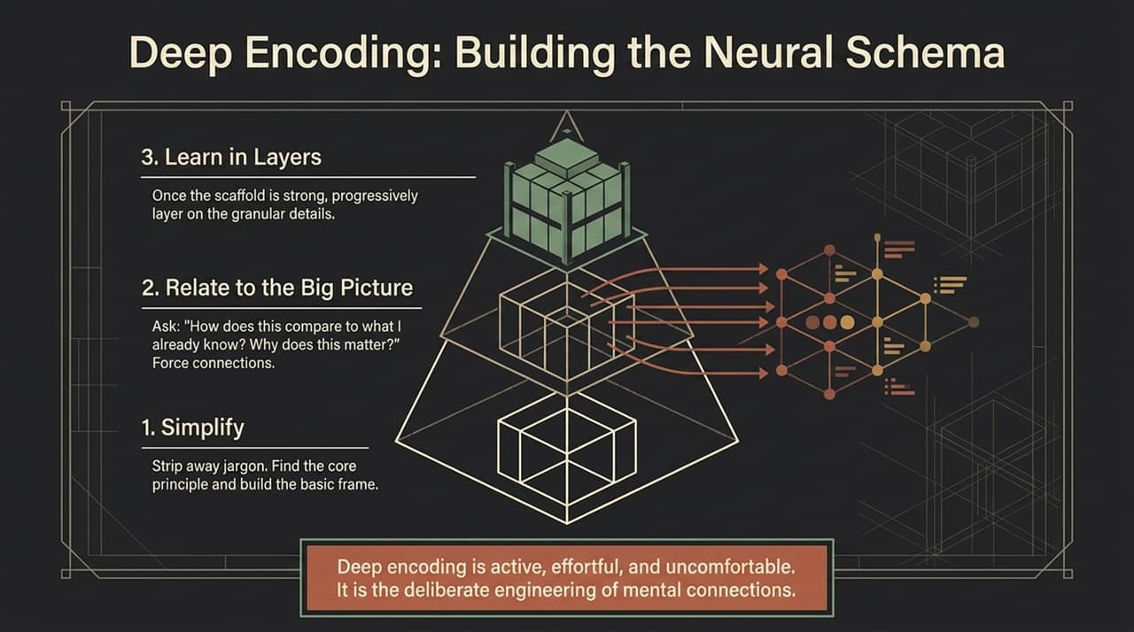
Notes:
How do we execute deep encoding? We follow a three-step layer model:
Simplify: Strip away complex jargon. Reduce concepts down to their core underlying principles to build the basic frame.
Relate to the Big Picture: Force connections. Constantly ask yourself: 'How does this relate to what I already know? Why does this matter?'
Learn in Layers: Once the structural scaffolding is solid, systematically layer on the granular details.
Deep encoding is deliberate, uncomfortable work, but it is the true engineering of mental schemas.

Slide 12
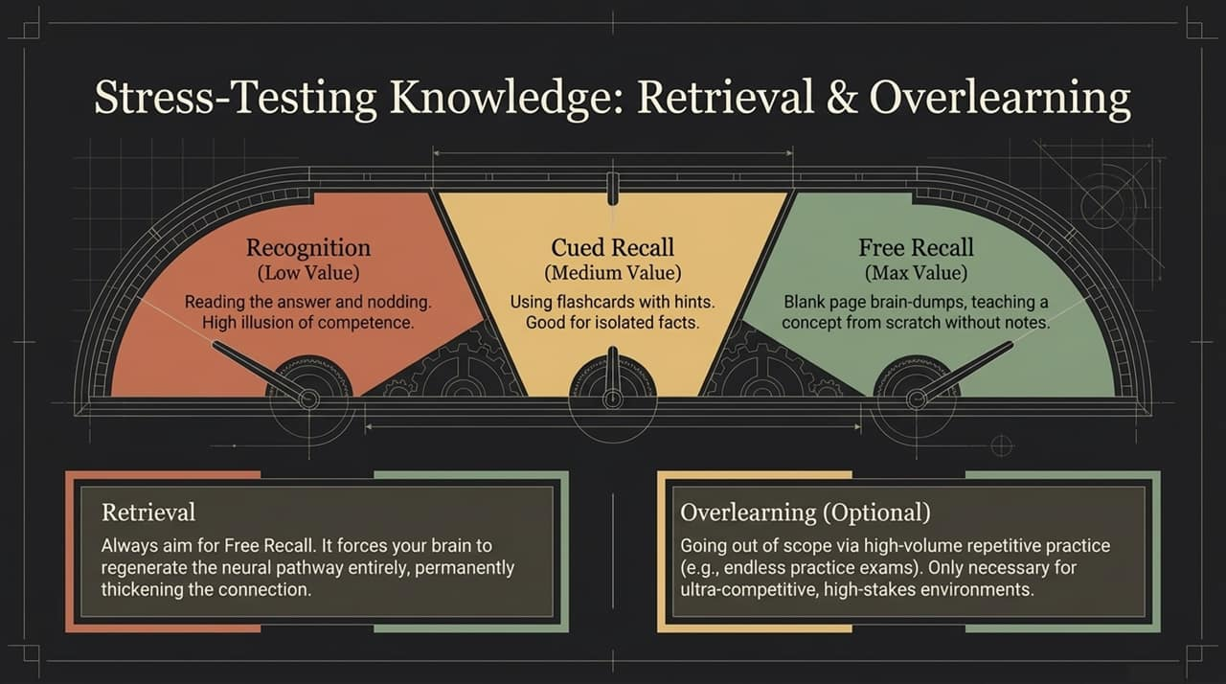
Notes:
When it comes to stress-testing your knowledge, aim for the highest value testing modality:
Recognition (Low Value): Nodding along while reading notes. Creates a false sense of security.
Cued Recall (Medium Value): Flashcards with prompt hints. Good for basic definitions, but limited.
Free Recall (Maximum Value): Blank-page brain dumps or explaining a concept from scratch without aids. Free recall forces your brain to reconstruct the neural pathway entirely, permanently thickening cognitive connections.

Slide 13
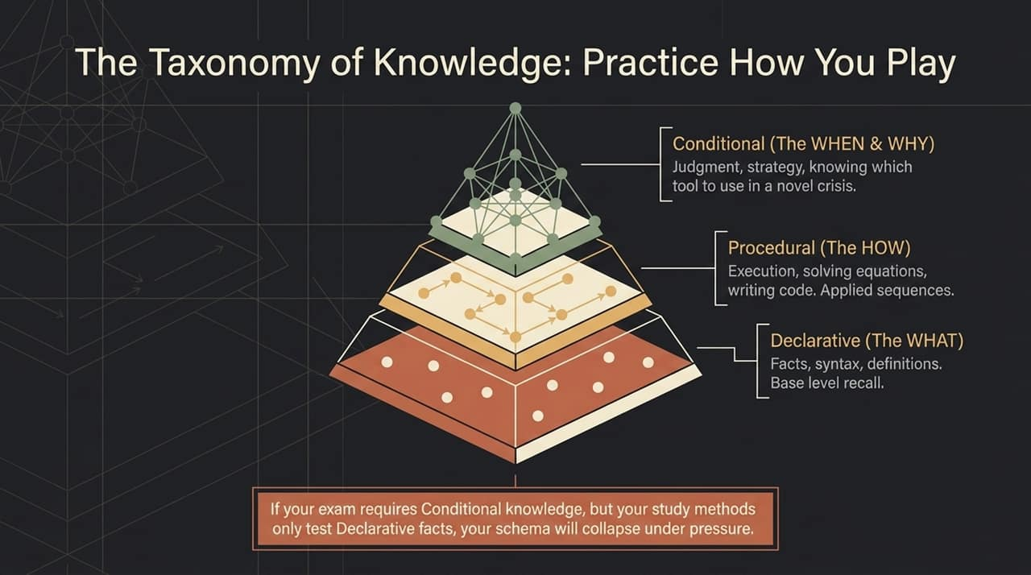
Notes:
Knowledge exists in three hierarchical tiers:
Declarative (The WHAT): Definitions, facts, syntax. Base-level recall.
Procedural (The HOW): Step-by-step execution, writing code, solving equations.
Conditional (The WHEN & WHY): Strategic judgment—knowing which tool or model to apply in an unfamiliar crisis.
Here is a crucial warning: If your performance environment demands Conditional knowledge, but your study habits only test Declarative facts, your mental schema will collapse under pressure. Match your retrieval to the depth required.

Slide 14
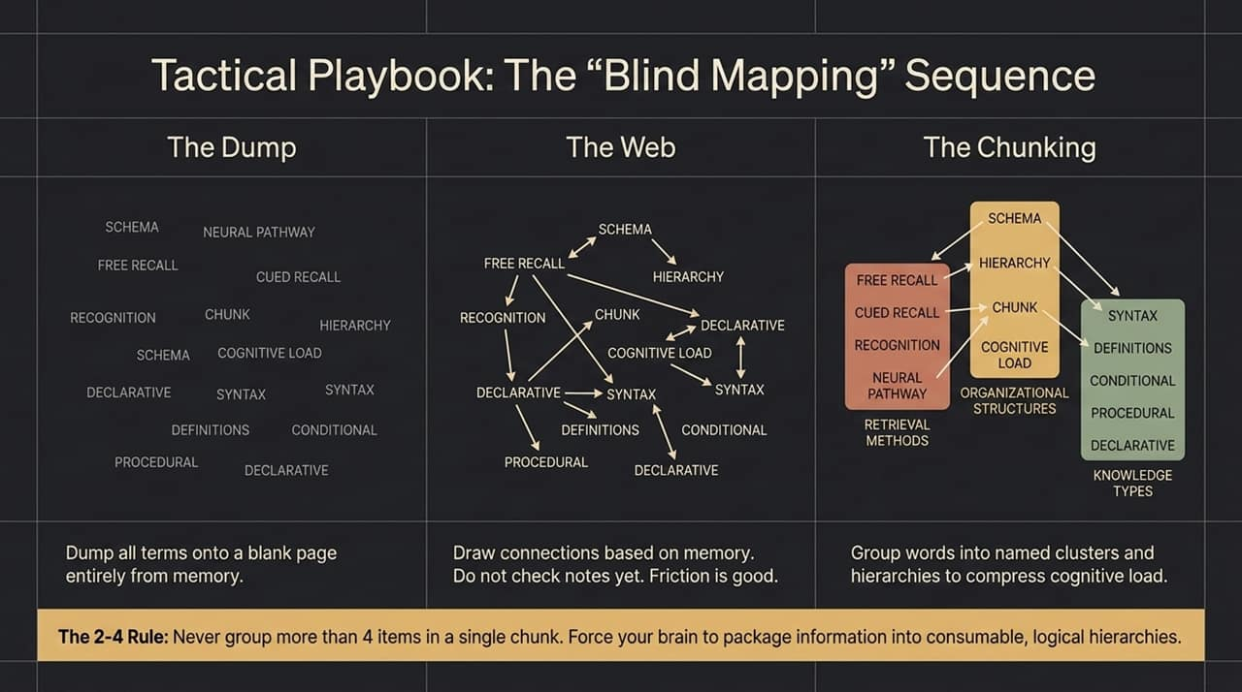
Notes:
To put this into immediate practice, use the Blind Mapping Sequence:
The Dump: Take a completely blank sheet of paper and dump every keyword, concept, and term you can remember from memory. No peeking at notes.
The Web: Draw relationships, arrows, and contrasts between these terms purely from memory. Embrace the friction.
The Chunking: Group concepts into named clusters. Apply The 2–4 Rule: Never group more than four items into a single cluster without creating a sub-hierarchy. This compresses cognitive load and builds clean, accessible neural pathways.

Slide 15
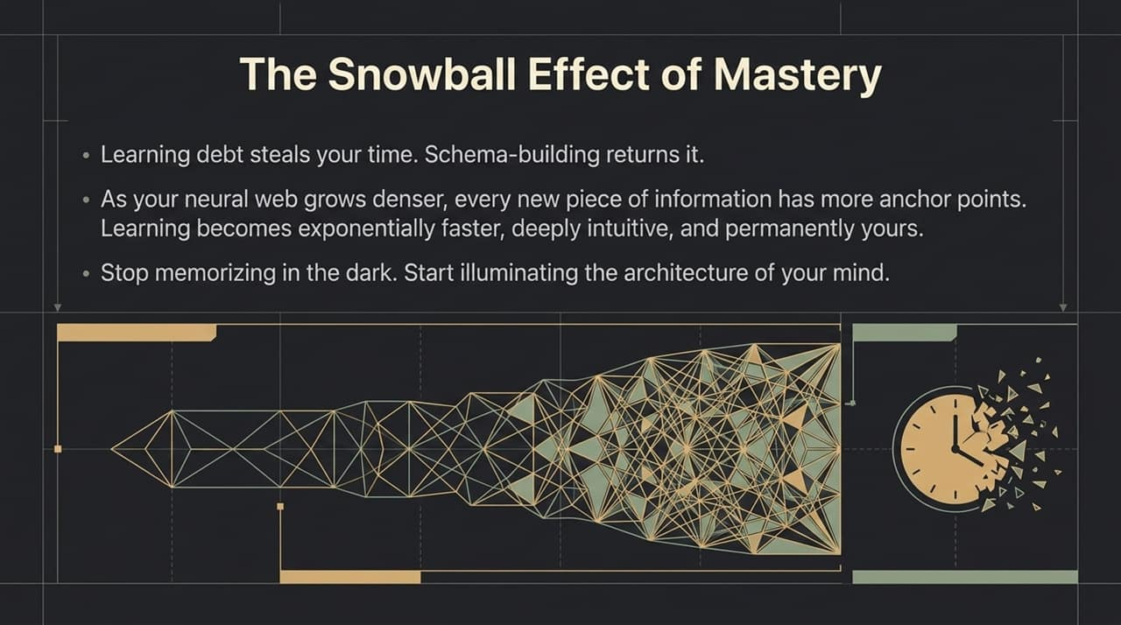
Notes:
When you transition away from learning debt and invest in schema-building, you trigger the Snowball Effect of Mastery.
Early on, encoding feels slow because you have few existing anchor points. But as your neural web grows denser, every new piece of information has dozens of existing schemas to link onto. Over time, learning new complex topics becomes exponentially faster, deeply intuitive, and permanently retained. Stop memorizing in the dark; start illuminating the architecture of your mind.

Slide 16
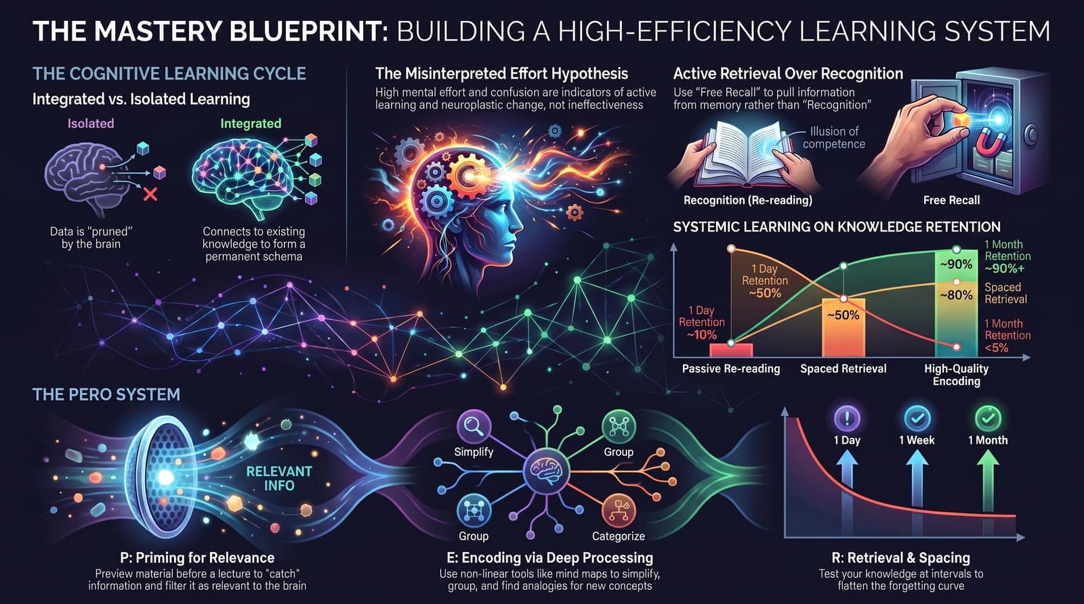
Notes:
To wrap up, let’s synthesize our complete Mastery Blueprint:
Embrace Cognitive Effort: High mental load and confusion are signs of neuroplastic growth, not failure.
Prioritize Active Retrieval: Shift from passive re-reading (which leads to <5% 1-month retention) to spaced free recall (which yields 90%+ retention).
Execute the PERO Cycle: Prime for relevance, deeply encode through non-linear structuring, offload minor details to reference tools, and test using active recall.
Master these principles, hold yourself to this cognitive standard consistently, and you will transform how you process, retain, and apply knowledge for the rest of your life. Thank you!

